Slide 1
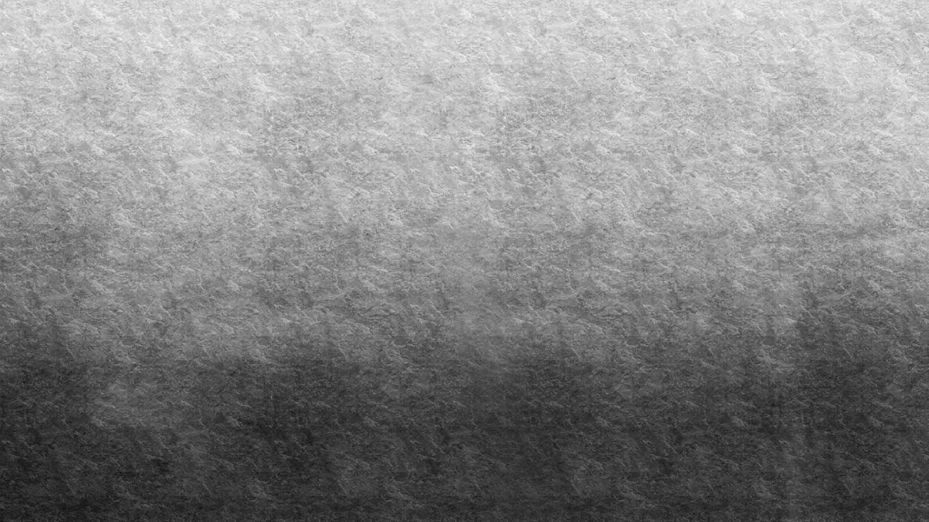
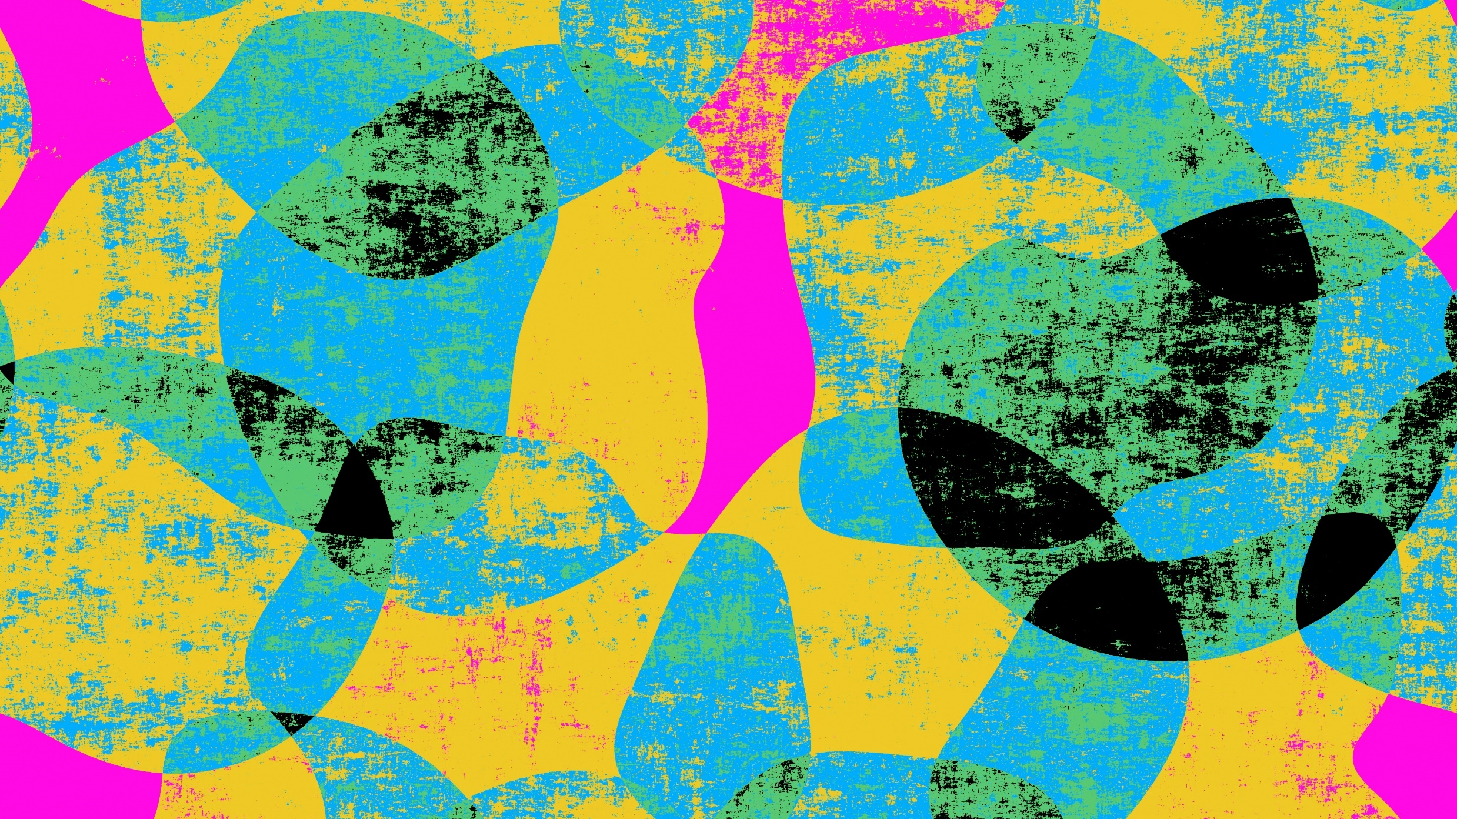
Artistic Style Transfer
Austin Hester CS 6420 – Image Processing Prof. Sanjiv Bhatia University of Missouri – St. Louis

Slide 2
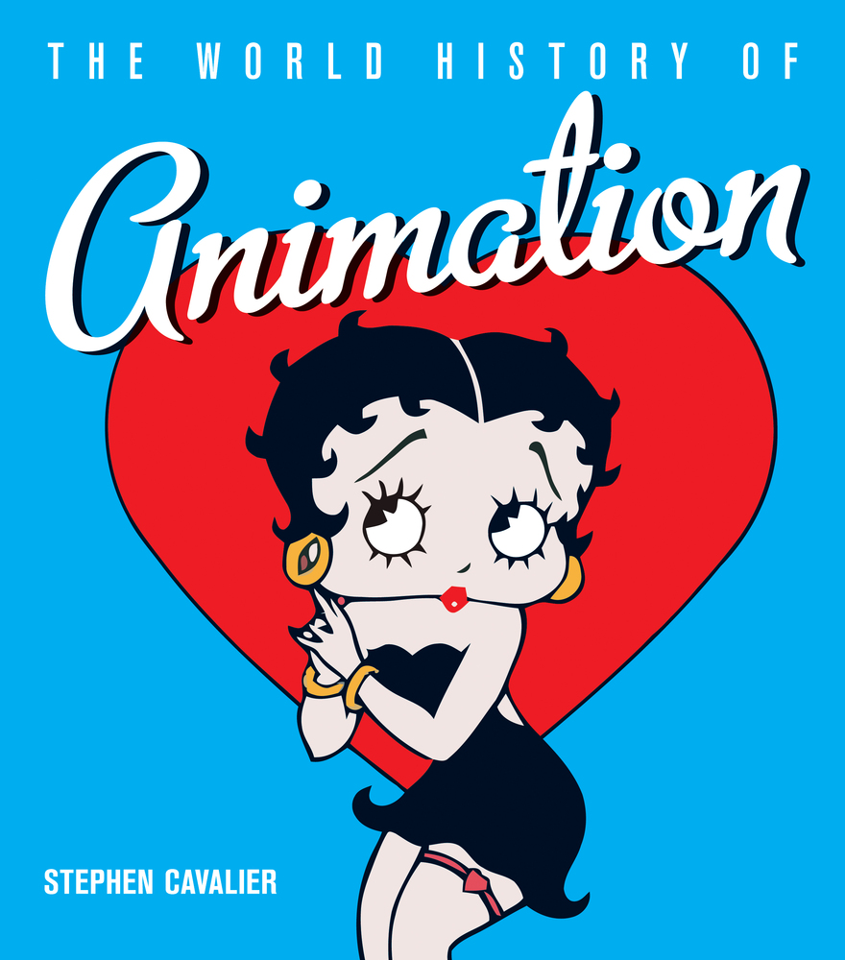
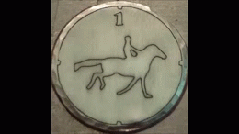
History
In the late 19th century, Eadweard Muybridge’s horse sequences were painted on glass discs.
These discs were used in a special projector called a zoopraxiscope, which they display in the bug-house at the St. Louis Zoo.
Also in the late 19th century, Claymation appears.
Pros: Real-life lighting, more concrete scenery.
Cons: Tedious, need a lot of clay.
In 1915, Max Fleischer invents Rotoscoping, which inspires many future animators.
Computer-Generated Imagery (CGI) first used in 1986 for Flight of the Navigator.

Slide 3
Rotoscoping Timeline
1915
Max Fleishcher invents Rotoscoping, known back then as the “Fleishcher Process.”
1918
Fleishcer’s animated series Out of the Inkwell (1918-197) starring Koko the Clown.
1934
Fleischer’s patent expires. Other studios begin using rotoscoping and a flood of animated works hit the silver screen.

Slide 4
Advantages of Rotoscoping
Efficiency
Motion Accuracy
Show how much the process is easier using rotoscoping
Show image of hand-animated vs. rotoscoped.

Slide 5
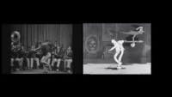

Slide 6
“Problem” Statement
Animation takes too gosh dang long.

Slide 7
Project Focus
What is style transfer?
What is it good for?
Why single frame?
Why not video?
Focus on single-frame style transfer.

Slide 8
Implementation
Points taken from papers…
Points taken from previous projects
Points made up
Why I didn’t want to use neural networks.

Slide 9
Implementation Workflow
Add flow chart from template image to target image to output image.

Slide 10
Code Snippets
Code #1
Code #2
Code #3

Slide 11
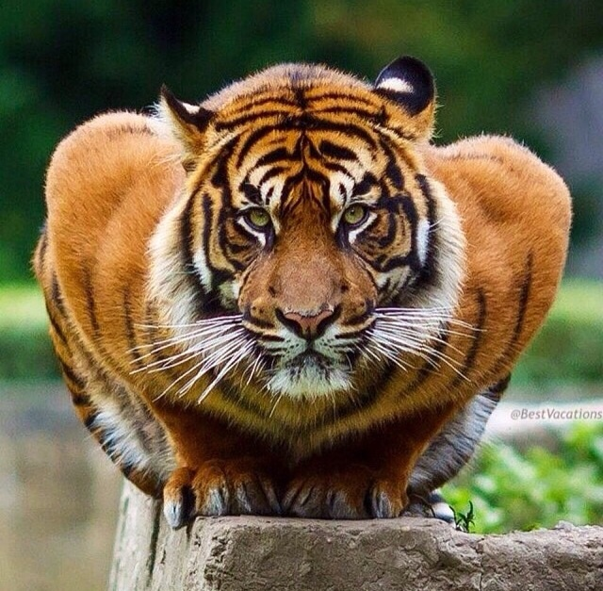
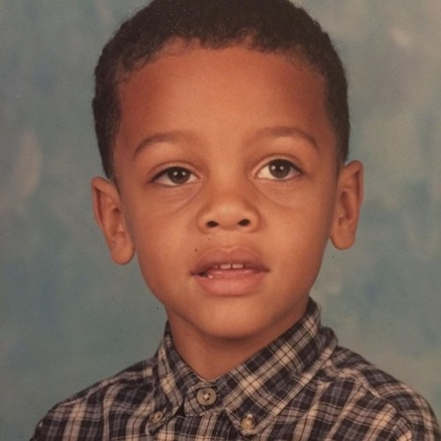
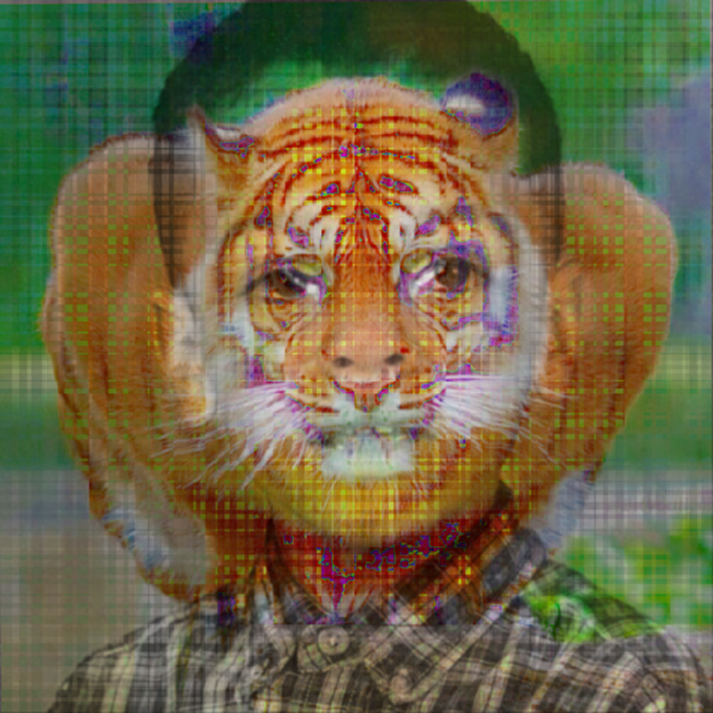
Example of Implementation
Template Image
Target Image
My Result

Slide 12
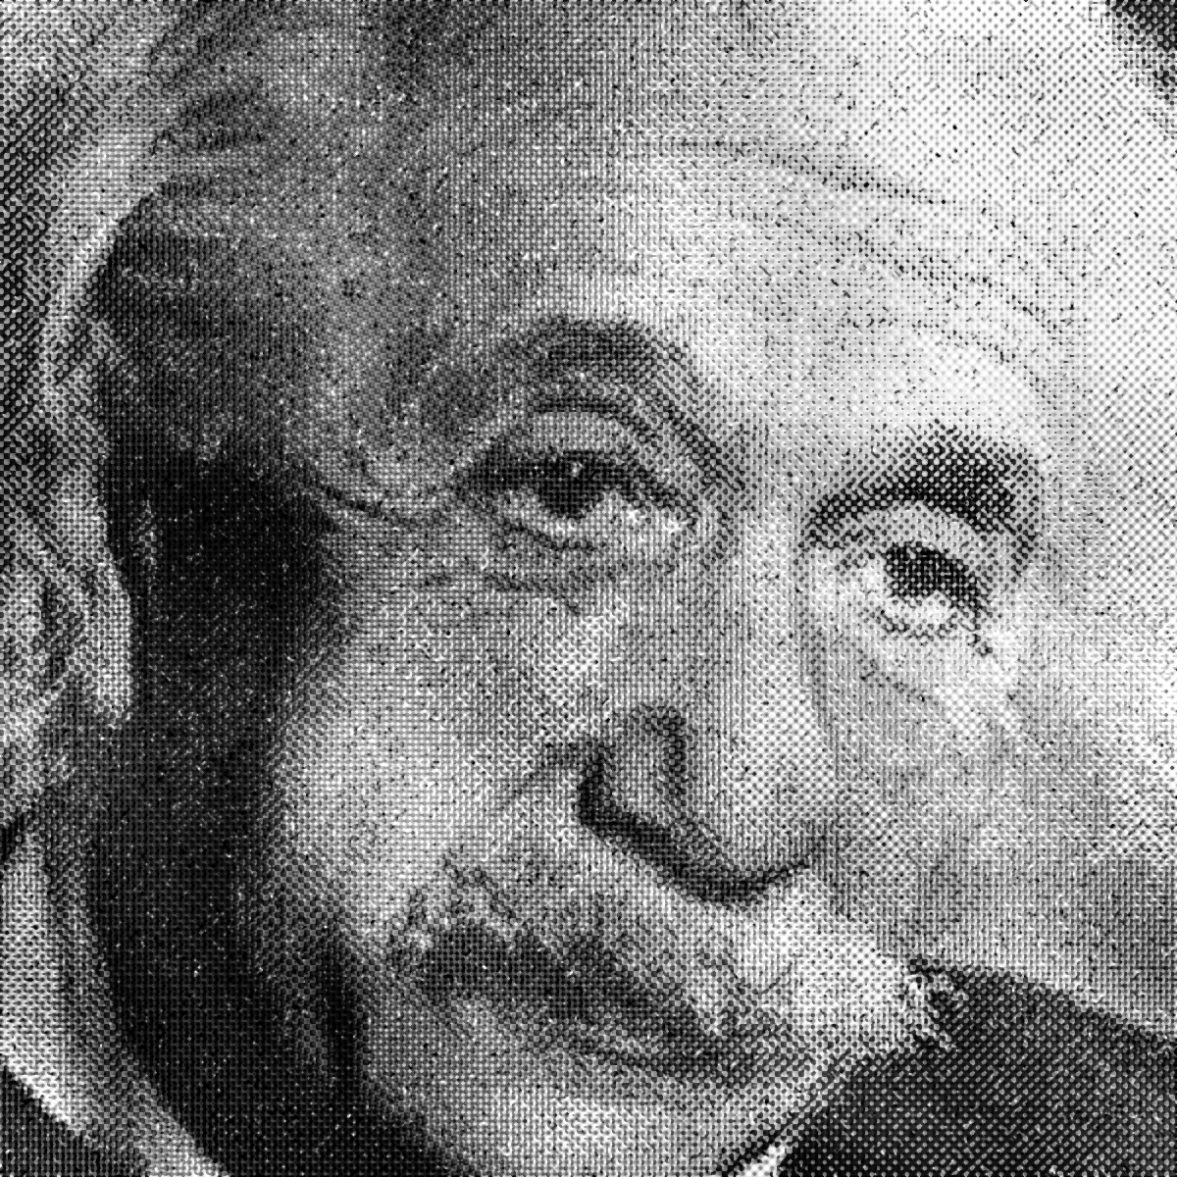
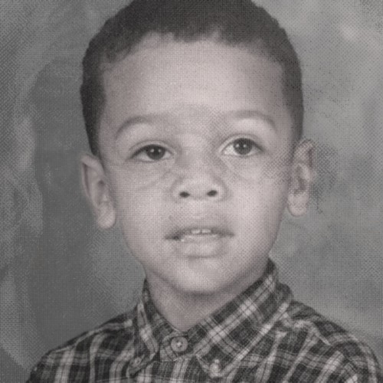
Example of Implementation
Template Image
Target Image
My Result

Slide 13
Example of Implementation
Template Image
Target Image
My Result

Slide 14
Problems Faced: Artistic Detail
Artistic styles with fine details are harder to transfer due to averaging and warping.
Artists depict a “mood,” which can be difficult to transfer to a target image.
Textures are difficult to transfer for the same reason as fine details.

Slide 15
Problems Faced: Identity Preservation
Need to transfer artistic style from source image to target image, while preserving the identity of the target.
e.g. Source image: Mona Lisa. Target image: Bill Gates.
We want our target image, Bill Gates, to be drawn in the same style as Mona Lisa, but the output image should still be identifiable as a portrait of Bill Gates.
Preserve attributes such as the shape, size, and position of facial features.

Slide 16
Problems Faced: Video
Temporal cohesion
Object tracking
Optical Flow

Slide 17
Problems Faced: Indecision
As I was learning more in class, my idea on how to implement a solution kept changing.
I ended up watching output-result videos, in awe, for far too long.
Other out-of-scope problems include client launches at work and the map project(s) taking a lot of time.
The class projects did help a lot in teaching me OpenCV enough to get some results from my implementation.

Slide 18
Example-Based Synthesis of Stylized Facial Animations
topics
Jamriška et al., (ACM Transactions on Graphics 2017). https://dl.acm.org/doi/10.1145/3072959.3073660

Slide 19
Paper Selection #1 Examples

Slide 20
FaceBlit: Instant Real-time Example-based Style Transfer to Facial Videos
topics
Texler et al., (Proceedings of the ACM on CGIT April 2021). https://dl.acm.org/doi/10.1145/3451270

Slide 21
Paper Selection #2 Examples

Slide 22
Future Work

Slide 23
Czech guy’s work

Slide 24
Futschik et al., STALP: Style Transfer with Auxiliary Limited Pairing
https://www.youtube.com/watch?v=2HkzT_k-dss

Slide 25
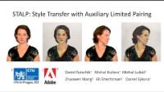

Slide 26
References
Daniel Sýkora, author on many papers listed here, has a website with much related work: https://dcgi.fel.cvut.cz/home/sykorad/
[1] Cavalier, Stephen. The World History of Animation. ISBN:9780520261129. (Aurum 2011). https://www.ucpress.edu/book/9780520261129/the-world-history-of-animation
[2] Futschik et al., STALP: Style Transfer with Auxiliary Limited Pairing (Eurographics May 2021). https://dcgi.fel.cvut.cz/home/sykorad/Futschik21-EG.pdf
[3] Jamriška et al., Example-Based Synthesis of Stylized Facial Animations (ACM Transactions on Graphics 2017). https://dl.acm.org/doi/10.1145/3072959.3073660
[4] Texler et al., FaceBlit: Instant Real-time Example-based Style Transfer to Facial Videos (Proceedings of the ACM on CGIT April 2021). https://dl.acm.org/doi/10.1145/3451270

Slide 27
